Slide 1

The Battle of Neighborhoods
Capstone Project- IBM Data Science Professional Certification

Slide 2
NEW YORK
New York City's demographics show that it is a large and ethnically diverse metropolis.
It is the largest city in the United States with a long history of international immigration. New York City was home to nearly 8.5 million people in 2014, accounting for over 40% of the population of New York State and a slightly lower percentage of the New York metropolitan area, home to approximately 23.6 million.
Over the last decade the city has been growing faster than the region. The New York region continues to be by far the leading metropolitan gateway for legal immigrants admitted into the United States.
Throughout its history, New York City has been a major point of entry for immigrants; the term "melting pot" was coined to describe densely populated immigrant neighborhoods on the Lower East Side.
As many as 800 languages are spoken in New York, making it the most linguistically diverse city in the world. English remains the most widely spoken language, although there are areas in the outer boroughs in which up to 25% of people speak English as an alternate language, and/or have limited or no English language fluency.
English is least spoken in neighborhoods such as Flushing, Sunset Park, and Corona.
NYC brings tourists in droves for its world-class museums, monuments, shopping, and theater. But it is also a city in which eating is often not something you do between activities, it is the activity.

Slide 3
Description of Problem
New York has one of the most competitive and diverse restaurant scenes anywhere in the world—one study from earlier in the decade found that 80 percent of restaurants in New York close in the first five years (though that also means new and exciting eateries are opening constantly). Whether you want a three Michelin star tasting menu, a big plate of comfort food or just the best freakin' slice of pizza you've ever had in your life, you can find it in New York City. There are many resturants in New york City, each beloning to different categories like Chinese , Indian , French etc.
In this project we will list and visualize all major parts of New York City that has great indian resturants so as to decide the place one can open an Indian food restaurant considering the concentration of the restaurants.
reference: https://www.cntraveler.com/gallery/best-restaurants-in-new-york-city
reference: https://en.wikipedia.org/wiki/Demographics_of_New_York_City

Slide 4
Questions
What is best location in New York City for Indian Cuisine ?
Which areas have potential Indian Resturant Market ?
Which all areas lack Indian Resturants ?
Which is the best place to stay if I prefer Indian Cuisine ?

Slide 5
Methodology
Using FourSquare API finding all venues for each neighborhood.
Filter out all venues which are Indian Restaurants.
Collect the new york city data from https://cocl.us/new_york_dataset
Find rating , tips and like count for each Indian Restaurants using FourSquare API.
Sorting the data using rating for each restaurant.
Visualize the Ranking of neighborhoods using folium library(python)

Slide 6
Data Collection
New York City data that contains list Boroughs, Neighborhoods along with their latitude and longitude.
Data source : https://cocl.us/new_york_dataset
Description : This data set contains the required information. And we will use this data set to explore various neighborhoods of new york city.
Indian restaurants in each neighborhood of new york city.
Data source : Fousquare API
Description : By using this api we will get all the venues in each neighborhood. We can filter these venues to get only Indian restaurants. GeoSpace data
Data source : https://data.cityofnewyork.us/City-Government/Borough-Boundaries/tqmj-j8zm
Description : By using this geo space data we will get the New york Borough boundaries that will help us visualize choropleth map.

Slide 7
Libraries needed:-
pandas and numpy for handling data.
Request module for using FourSquare API.
geopy to get co-ordinates of City of New York.
folium to visualize the results on a map

Slide 8
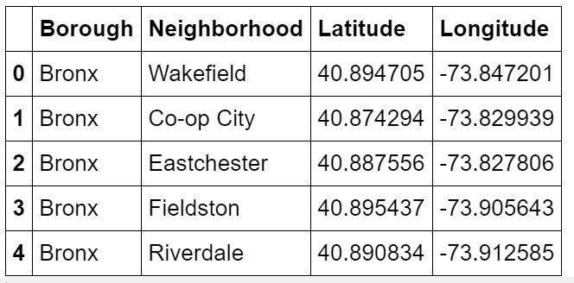
Step 1
Load data from https://cocl.us/new_york_dataset in pandas Dataframe.
Getting Latitude and Longitude for each address geopy library.
We have 306 rows like this.

Slide 9
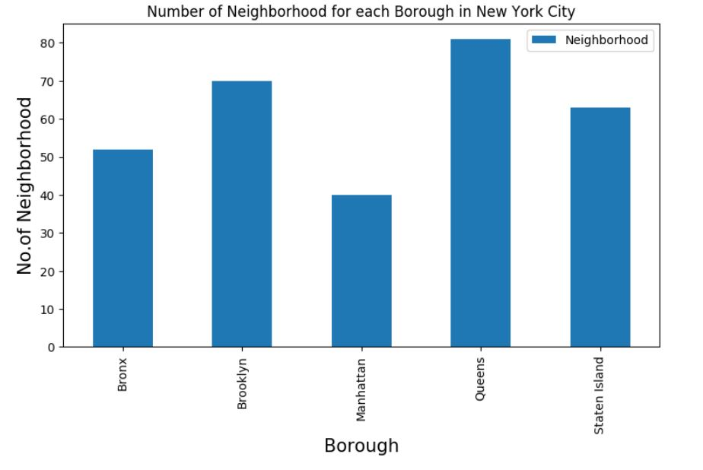
Number of neighborhoods in each Borough

Slide 10
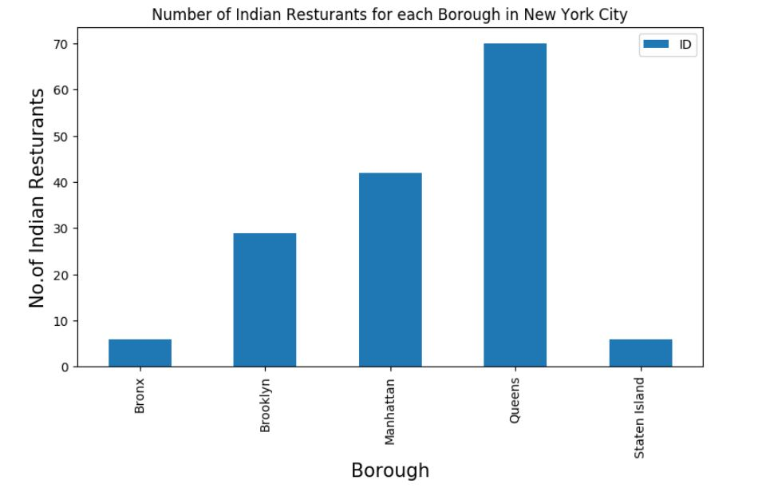
Step 2 - Filter out which Borough and Neighborhood have maximum number of Indian Restaurants using FourSquare API
Result – Queens has maximum number of Restaurants

Slide 11
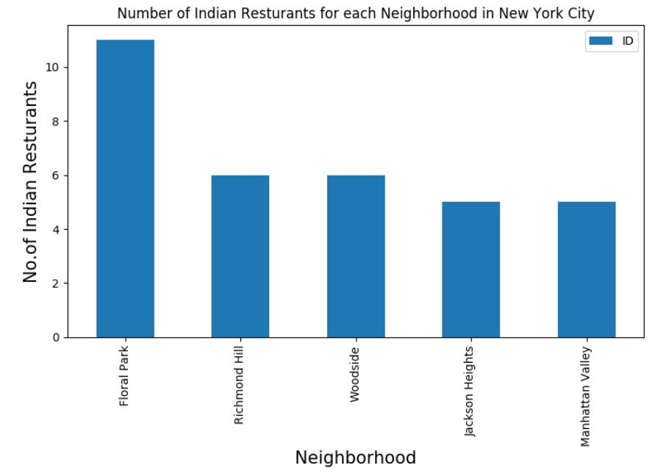
Step 2
Result – Floral Park has maximum number of Restaurants

Slide 12
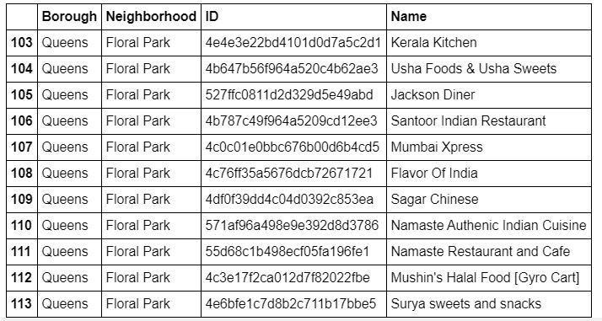
List of Restaurants in Floral Park

Slide 13
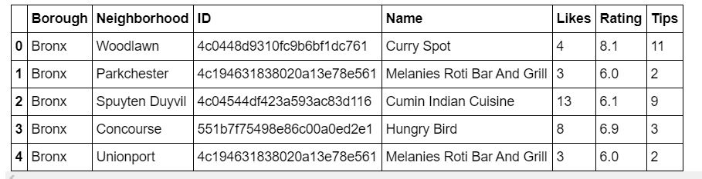
Step 3-Get likes, ratings, tips on each of Indian Restaurant using FourSquare API

Slide 14
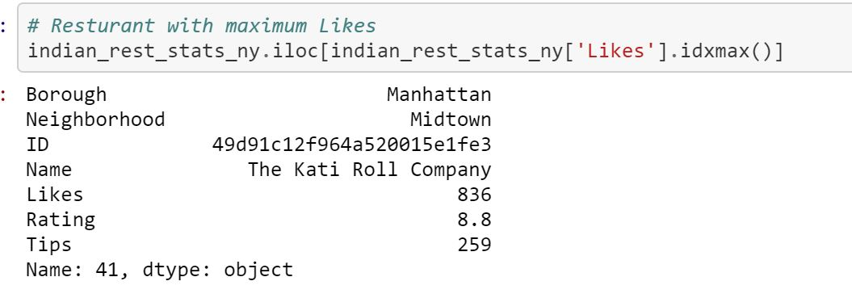
Results
Result
Restaurant with maximum like

Slide 15
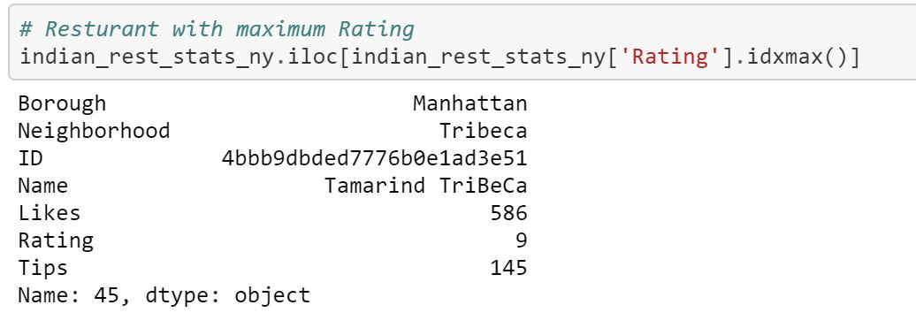
Result
Results
Restaurant having maximum Rating

Slide 16
The best neighborhoods for indian cuisines are- Astoria(Queens), Blissville(Queens) and Civic Center(Manhattan)
The highest potential for Indian Resturant is the market area in Manhattan
The least average rating of Indian Resturants is in Staten Island. The reasons could be further investigated.
For an Indian Cuisine lover Manhattan is the best place to visit and eat
If one wants to open a new Indian cuisine restaurant, Manhattan is best choice.
Other options to be considered are- Astoria(Queens) and Blissville(Queens)
Conclusion

Slide 17
Limitations
The potential is estimated on the basis of ratings of resturants which is based on the judgement of foursquare users.
The accuracy of data depends on the data provided by FourSquare

Slide 18
Thank You
- Jyoti

